Slide 1
Electronics & Electricity
Unit 6 – Power Industry
Section 1 – Generally Used Energy Sources

Slide 2
The big idea
Describe four sources of energy, other than fossil fuels that can produce electric energy
Explain process of generating electricity in each of the three main types of electric power plants

Slide 3
Terms
Atomic Fission
Cogeneration
Electrolyte
Fossil Fuel
Geothermal Energy
Grid
Photovoltaic Cell
Reactor
Solar Array
Transmission Line

Slide 4
Generally Used Energy Sources
Modern power plants mostly consist of:
1. Fossil Fuel plants
2. Nuclear Plants
3. Hydroelectric Plants
Electric energy is then produced and delivered to the user by means of transmission line networks, or the grid.
Turbines is the main turning force for these plants, and are turned by steam pressure or moving water. Smaller generators use an energy source of gasoline or diesel in the same principal to turn a turbine,.

Slide 5
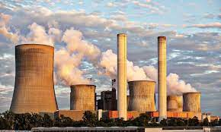
Fossil Fuel Power Plants
The earliest type of power plant and still the most common
Water is heated in a boiler to create steam
The FUEL used to heat the water can be coal, oil, or even natural gas (Fossil Fuels)

Slide 6
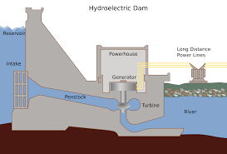
Hydroelectric Power Plants
Water from a river, lake, or reservoir is directed against the blades of a turbine by gravity
The water pressure cause the shaft of the turbine to rotate
Not only are the dams used to control water flow in these plants, it also helps with floods

Slide 7
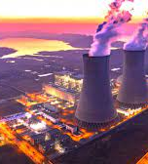
Nuclear Plants
The fuel used in nuclear power plants is uranium
An atomic particle, strikes the nucleus of a uranium atom and splits
Process is known as Atomic fission
Fission causes large amounts of energy which causes more splits to occur (Nuclear Reaction)
The heat caused by the reaction boils water, and the steam produced operate turbines to create electric energy

Slide 8
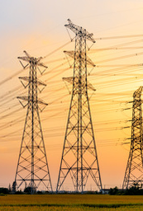
Transmission System
Used to carry electric energy from power plants to places to be used
Voltage as high as 250,000 Volts is carried
Transmission lines
Transformers
Substation and Distribution Networks

Slide 9
Other Energy Sources
There are several problems that are created with the current energy sources used today:
Depleting supplies
Polluting of the environment
Depending on external sources for fuel supplies
Spending large amounts of money on imported fuels
Photovoltaic
Wind
Ocean Heat
Geothermal Energy
Wave Motion
Biomass
Fuel Cells

